Slide 1
Impact Assessment of SPS Measures
Avocado case study - Kenya
Meeting of Experts to Update EAC Harmonised SPS Measures and Procedures Documents
Kampala, 24 - 27 May 2010
Edewa, Otieno, Kleih

Slide 2
Background to the Ban
On 22 February 2007, South Africa issued an informal notice to Kenya banning all avocado imports from Kenya with immediate effect.
This was not done through the official notification mechanism provided for in the WTO Notification Procedure.
The National Plant Protection Organization (NPPO) of South Africa wrote to the Kenya Plant Health Inspectorate Service (KEPHIS), the NPPO of Kenya, an email to recall all SA Import Permits on avocado imported from Kenya.
According to the Directorate of Plant Health, which is the NPPO of South Africa, records regarding distribution of Bactrocera invadens (Fruit fly) in Africa and the important quarantine status this organism has for South Africa necessitated amendment of their import conditions.

Slide 3
Background to Bactrocera invadens
B. invadens was first detected in coastal Kenya in February 2003 according to ICIPE;
This species had initially been overlooked as unusual variant of several other species;
B. invadens is highly polyphagus and has to date been recorded in 25 host species belonging to 13 plant families;
B. invadens is established in several parts of Kenya, with low infestation towards high altitude areas which serve as avocado production areas;
The economic impact of B. invadens is likely to be considerable as import restrictions to non-infected countries for mango and similar crops are strengthened.

Slide 4
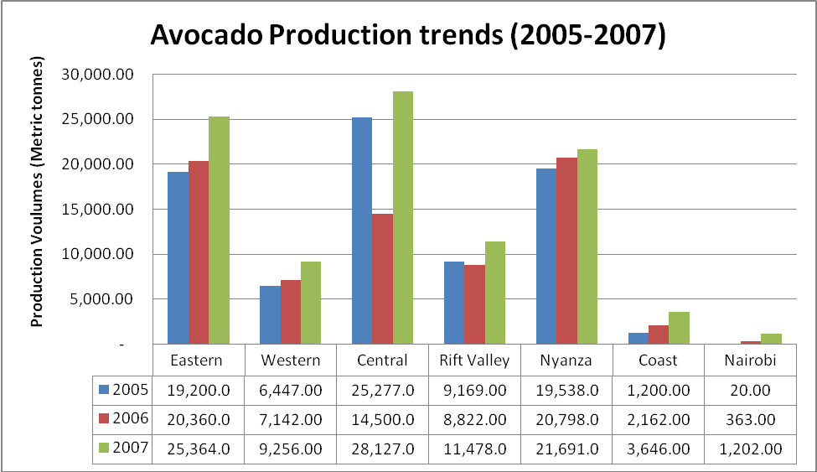
Avocado production trends in Kenya

Slide 5
Kenyan Avocado Exports
Avocado (Persea americana) is native to South America and is one of the most important export fruits grown in Kenya.
Apart from its nutritive value, its oil is used in the preparation of cosmetics.
It is exported mostly to France, Holland, United Kingdom and Spain.
Other markets include Germany, South Africa, and United Arab Emirates.
Fuerte and Hass are the two main export varieties, but preference is shifting towards Hass.

Slide 6
Avocado exports to South Africa - 2007
Total volume of Kenyan Avocado exports (kgs) | 15,115,748
Avocado exports to South Africa (kgs) | 228,898
Percentage of export volume to South Africa | 1.5%
Total value of Kenyan avocado exports (Kshs) | 872,421,646
Value of avocado exports to South Africa | 20,066,112
Percentage of export value to S Africa | 2.3%

Slide 7
Initial outcomes of the ban
Lost exports - it is estimated that the presence of Bactrocera invadens in Kenya has resulted in the ban of avocado exports to South Africa worth over Kshs. 150 million (USD 2.1 million);
This ban further threatens growth of the horticultural industry in Kenya as other important fruit exports from Kenya may soon be treated similarly by other markets;
At the micro level, individual exporters affected experienced significant losses both in quantities exported and total revenue generated;
The South African market was a special market for Kenya to cover for South Africa’s seasonal avocado production lapse from October to February.

Slide 8
Changes to production, processing and marketing systems
Although the acreage under smallholder avocado production has not reduced following the ban, it is evident that many smallholders are now converting their avocado orchards from Fuerte to Hass, which is the preferred variety for the EU market
There have been no changes so far in exporter practices for post-harvest handling management of avocadoes after the ban;
As for the exporting companies, the impact was insignificant as the pack houses remained operational to serve other markets
On the supply side, however, the exporting companies no longer link straight with small holder producers owing to difficulties in controlling and managing their big number. Instead, export companies satisfy their market orders through use of approved suppliers.

Slide 9
Economic impacts
In particular, smallholder producers lost out due to the ban;
According to the Maragua District Horticultural Crops Officer the South African ban of avocado imports from Kenya has had a serious change in avocado marketing channels;
Smallholders have been pushing most of their crop to the domestic wholesale and processed markets at very poor prices of approximately Kshs 0.50 per piece (less than Kshs 5 per kg);
In terms of employment, casual workers who would be employed by farmers for harvesting operations can no longer be hired if market outlets are not guaranteed;
Also, there has been loss of additional jobs by casual labourers who would otherwise be employed in pack-houses to pack avocadoes for the South African market between October and February.

Slide 10
Social impacts
With reduced farm incomes, smallholders who depend mainly on avocado as cash crop are finding it difficult to meet their financial obligations.
One of the most notable social impacts is the disintegration of smallholder producer groups.
Producers who would otherwise work together have now adopted an individualistic approach in production and marketing of avocado due to failure in the contractual system with exporters or linkage firms.

Slide 11
Environmental impacts
Under formal contractual farming with exporters before the ban, producers were required under their quality management system to have an environment management plan and a wildlife conservation policy.
With collapse of controlled farming, it is unlikely that cautious environmental practices will be observed. Already clearing of some orchards has occurred and wood being used for firewood.
Although use of crop protection products may reduce owing to less quality demands especially in the domestic market, farmers are unlikely to engage services of commercial spraying. With limited knowledge misuse and abuse of hazardous products may occur. Poor soil conservation practices and risks associated with water contamination due to reduced awareness on hygiene issues may pollute the water courses.

Slide 12
Institutional impacts
Through various stakeholder meetings Kenya has resolved that only scientific facts presented in accordance with the relevant standards of the IPPC will be used in the course of technical discussions and these should be clearly elaborated in the country position.
It has been further proposed that the technical meeting should be on government to government basis and that besides KEPHIS officers, the team should also include a member from KARI (Kenya Agricultural Research Institute).
In order to find a solution out of South Africa’s action, the Kenyan government, industry and the NPPO have for the first time ever worked very closely. The government through KEPHIS has constantly engaged South Africa in technical information exchange.

Slide 13
Flanking measures - economic
As smallholders production constitutes over 85% of all avocado production, there is need to help the producers establish sustainable producer groups with strong leadership and management structures as well as business acumen.
The middlemen/brokers should not be viewed negatively, as they play a crucial role in sourcing of produce and supplying specific markets.
The need to promote lead firms that work with producers needs to be explored further.

Slide 14
Flanking measures - social
Commodity and market diversification should be the focus of the industry facilitated by government.
Knowledge is the starting point of any successful programme.
It is essential to map out social-economic activities within the production regions that will engage common interest groups like youth, women or even vulnerable groups into productive activities that can generate income and maintain the social fabric of the smallholder producers.

Slide 15
Flanking measures - environmental
In order to manage the environment responsibly, producers should be assisted to implement simple techniques that will mitigate negative impacts to soil, water and air. This may include utilizing agricultural waste for energy production, animal feed, fertilizer or other purposes.
Special programmes for afforestation, soil conservation, rational use of agricultural inputs and renewable energy technologies can be introduced as part of the social responsibility of different buyers of produce in the region. This will enhance environmental management and build a positive image for a lasting producer-buyer relationship.

Slide 16
Flanking measures - institutional
There is need to bring together all stakeholders in the avocado and other fruits sub-sectors to a common forum that will discuss issues openly and develop strategies for effective management of quarantine pests and other inherent problems.
In order to focus fully on the ban and develop feasible proposals, the National Horticulture Task Force should spearhead the process and treat it as a matter of priority for Kenya
There is need to redefine SPS coordination mechanisms and routine operations of the National Notification Authority
.

Slide 17
Flanking measures – institutional, ctd.
The government should strengthen its extension personnel by providing training and awareness on new and emerging issues such as identification and management of B. invadens
A regular surveillance programme throughout the year should be introduced to detect any incursion of B. invadens in production areas of known hosts. Trapping with Methyl Eugenol and Biolure should be carried out to determine pest status.
Eradication of B. invadens should be initiated with the duration of the eradication measures covering at least two generations.
KEPHIS has set up surveillance traps in avocado production areas and has introduced routine surveillance as part of an early warning system for B. invadens. The early warning system is managed centrally through a GPS (Global Positioning Satellite) system.

Slide 18
Conclusions
Without negotiations and with all flanking measures in place, it is very unlikely that the ban will be lifted. Should this be the case, there is likely to be a retaliatory trade sanction by Kenya.
The Ministry of Trade in Kenya needs to take the lead in bilateral negotiations, because the avocado ban is a trade dispute between two countries. Although the negotiation teams must include experts from the NPPOs, the latter are only competent authorities who should provide information to support the negotiation process,
If bilateral negotiations are successful with flanking measures in place, the ban is likely to be lifted and avocado exports from Kenya to South Africa will resume.
Kenya has to take advantage of the opportunity provided by South Africa’s willingness to have a bilateral meeting as an important step towards getting a solution to the trade dispute.

Slide 19
Thank you for your attention !

